Slide 1
Review of C Programming Language
By Dr. Juan Gomez

Slide 2
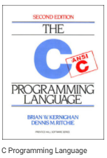
Source

Slide 3
Basic C Program

Slide 4
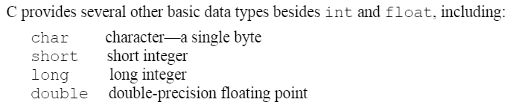
Basic Data Types

Slide 5
Arrays

Slide 6
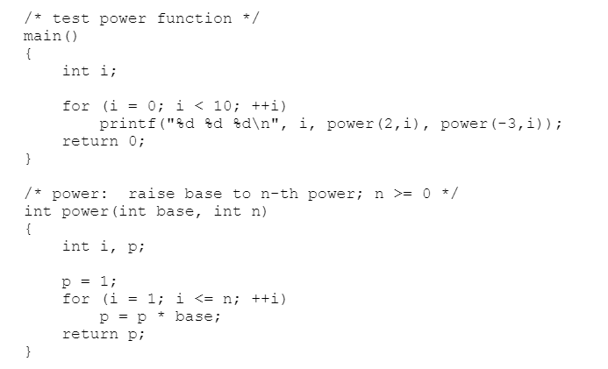
Functions

Slide 7
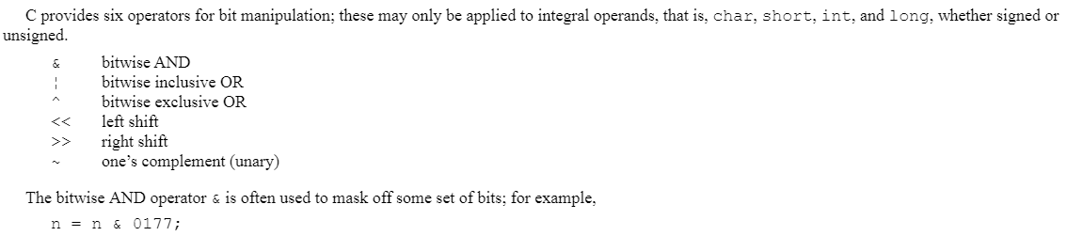
Bitwise Operators

Slide 8
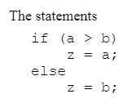
Conditional Expressions

Slide 9
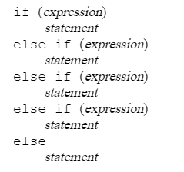
Flow Control: if/else

Slide 10
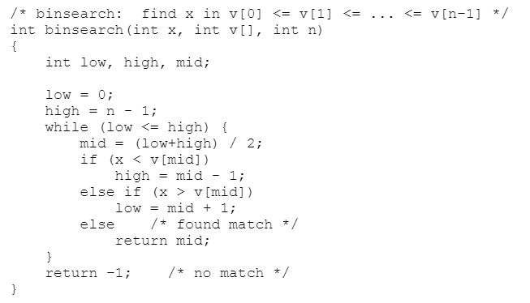
Example: flow control

Slide 11
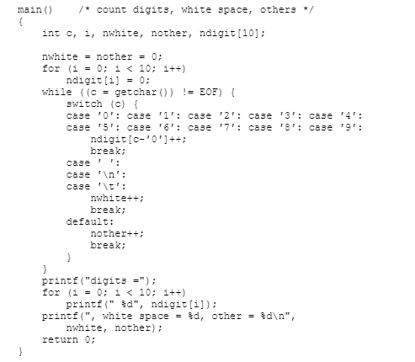
Flow Control: switch statement

Slide 12
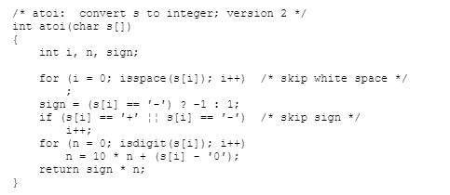
Loops: for()

Slide 13
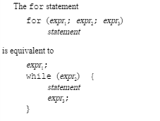
Loops: while

Slide 14
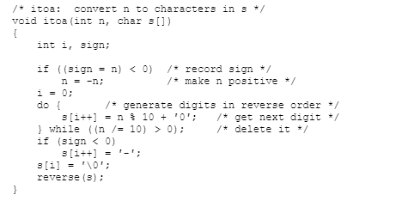
Loops: do while

Slide 15

Loop control: break and continue

Slide 16
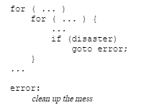
Flow control: goto and labels

Slide 17
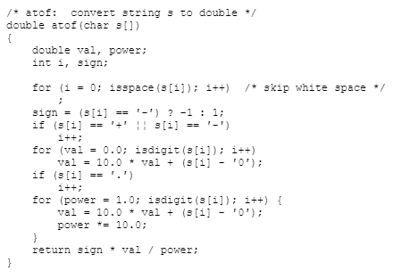
Functions: Arguments and Return Values

Slide 18

Static Variables

Slide 19

Register Variables

Slide 20

Scope of variables

Slide 21
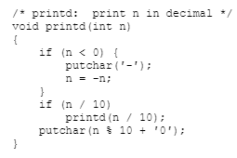
Recursion

Slide 22
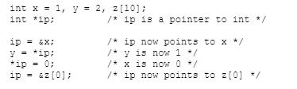
Pointers and Addresses

Slide 23
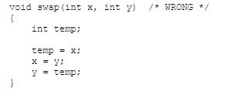
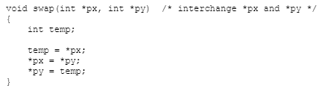
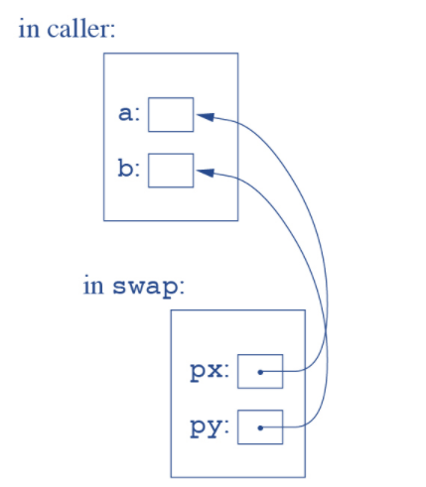
Pointers and Function Arguments

Slide 24

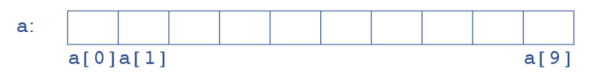

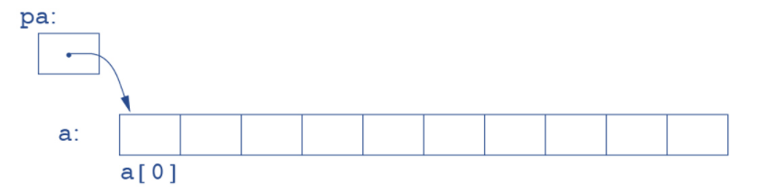
Pointers and arrays

Slide 25
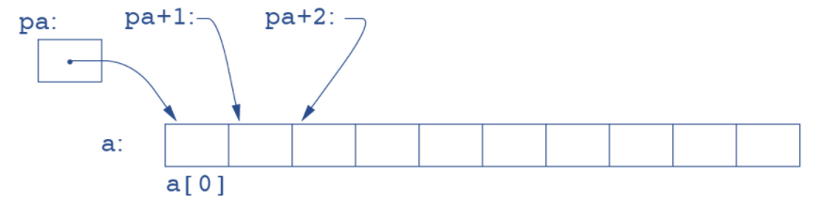
Array traversal based on pointer

Slide 26
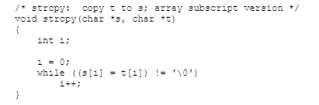
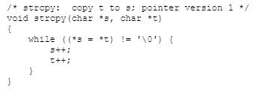
Arrays and Character Pointers

Slide 27
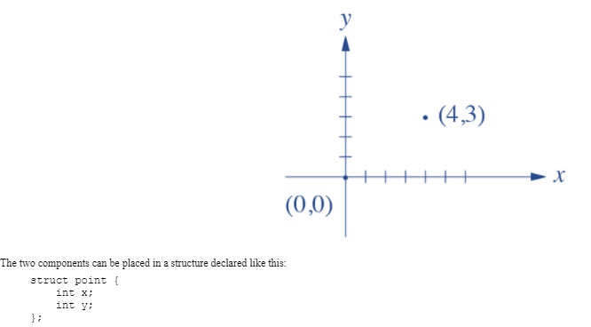
Structures

Slide 28
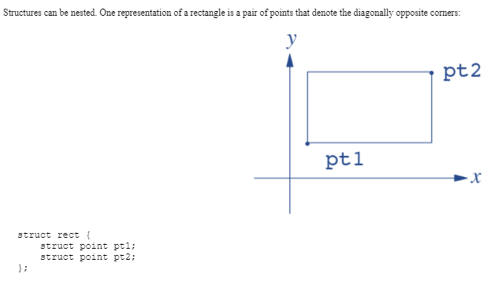
Nested Structures

Slide 29
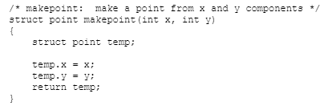
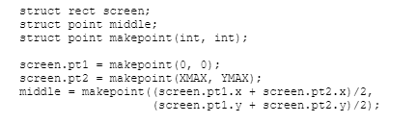
Using structures

